Slide 1
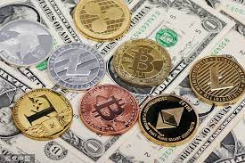
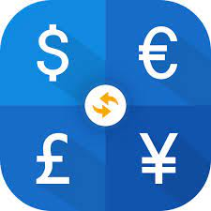
Currency Converter
An application that allows you to convert currencies of all type
By Toki Adeosun

